Slide 1
Linux basic commands for aws & devops
vikas
Notes:
We will have the Introduction Lectures First: History of Unix What is Unix Vs Linux ? Then What is GNU Linux ? What is Linux Distributions ?
What is OS ?
Virtualization
Linux File system
Common Linux Commands
Package Manager
User and permission
Bash Scripting
Networking
SSH Unix Architecture

Slide 2
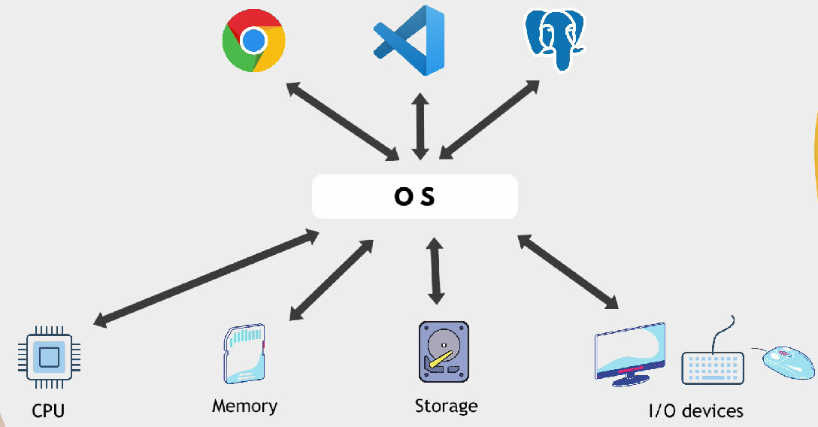
Notes:
Resource allocation & Management

Slide 3
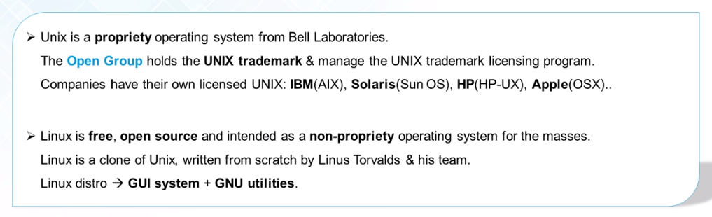
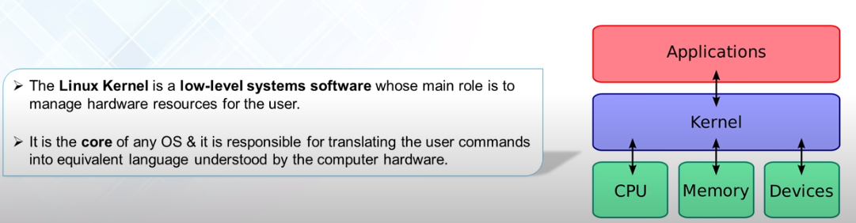
Notes:
The history of Unix dates to the mid-1960s when the Massachusetts Institute of Technology, AT&T Bell Labs, and General Electric were jointly developing an experimental time-sharing operating system called Multics for the GE-645 mainframe.
Multics introduced many innovations but had many problems.
Bell Labs, frustrated by the size and complexity of Multics but not the aims, slowly pulled out of the project. Their last researchers to leave Multics – Ken Thompson, Dennis Ritchie, Doug McIlroy, and Joe Ossanna among others – decided to redo the work on a much smaller scale.In 1979, Dennis Ritchie described their vision for Unix. and from there the Journey Started ...
Fullscreen
https://www.tutorialspoint.com/difference-between-linux-and-unix#:~:text=Linux%20is%20open%20source%20and,and%20is%20not%20open%20source.&text=Linux%20is%20used%20in%20wide,on%20servers%2C%20workstations%20or%20PCs.
Linux is the kernel: the program in the system that allocates the machine's resources to the other programs that you run. GNU is responsible for the utilities , Shell and more ... linux = GNU + Linus Torvald's Kernel

Slide 4
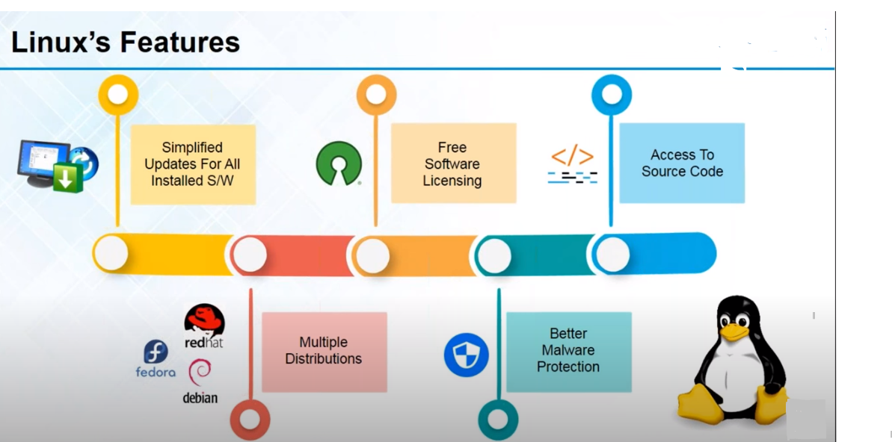
Notes:
UNIX is a OS
In 1980’s there was a GNU project which introduced LINUX Kernel .
https://danielmiessler.com/study/fedora_redhat_centos/
Various Distributions :
===============
REHL – Commercial servers
Fedora – Free version of REHL
Debian – Devloped by a set of developers free for usage
Ubuntu – free
Centos - free
Many more
ps –f
Environment variables :
echo $USER, echo $HOST, echo $HOSTNAME , echo $SHELL
&& and | and ;

Slide 5
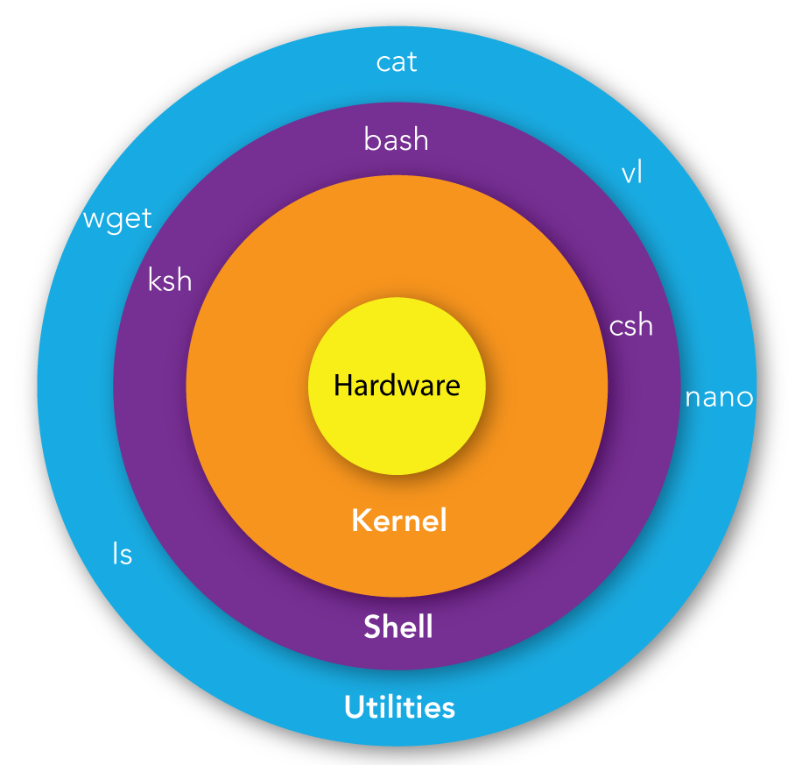
Notes:
Multiple user can login simultaneously .
Shell encloses the environment.
What is The Shell ? A Shell provides you with an interface to the Unix system. It gathers input from you and executes programs based on that input. When a program finishes executing, it displays that program's output. Shell is an environment in which we can run our commands, programs, and shell scripts. There are different flavors of a shell, just as there are different flavors of operating systems. Each flavor of shell has its own set of recognized commands and functions. What is Shell Prompt ? The prompt, $, which is called the command prompt, is issued by the shell. While the prompt is displayed, you can type a command. Shell reads your input after you press Enter. It determines the command you want executed by looking at the first word of your input. A word is an unbroken set of characters. Spaces and tabs separate words. Examples: ubuntu@My-Computer:~$ root@ip-192-168-1-206:~$ What is This Tilde (~) ? The tilde (~) is a Linux "shortcut" to denote a user's home directory. Thus tilde slash (~/) is the beginning of a path to a file or directory below the user's home directory. For example, for the ubuntu user, file /home/ubuntu/test.file can also be denoted by ~/test.file Note: this if you are currently logged in as Ubuntu user so ~ will refer to the home directory of ubuntu but if you are logged in as another user for example root it will refer to the root's Home directory which is /root What is the SuperUser (root) ? Superuser is the generic term to refer to the user account used for system administration (Full Permission). In Linux operating systems the superuser is the account whose UID (user identifier) is zero, no matter how it is named. and it's named root by default.

Slide 6
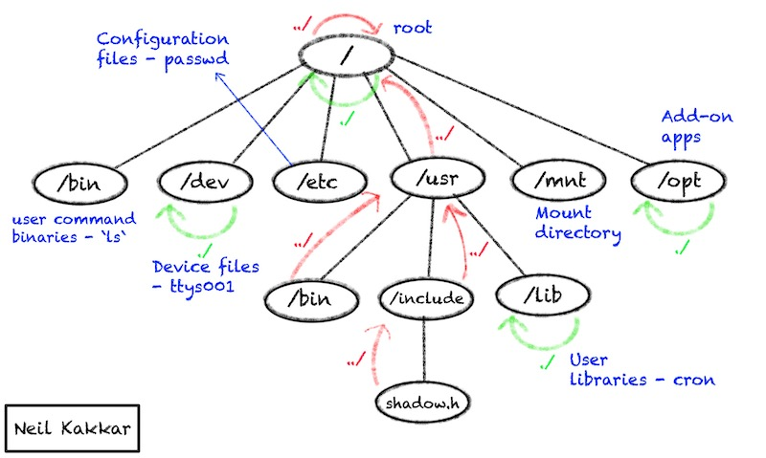
Notes:
ls / == > top level directory on linux file system
ls /bin -- > list of command executed
ls /boot == > includes linux startup files
ls /etc == > includes config files
ls /dev == > all the h/w and s/w devices details
ls /home == > home directory for every user
ls /lib == > libraries for kernel
ls /mnt == > list of devices mount
ls /opt == > contains application binaries
ls /proc == > list process running on kernel
ls /sbin == > admin related commands
ls /tmp == > temporary directory
ls /user == > list of small programs accessible to users
ls /var == > variables like log file are stored here

Slide 7
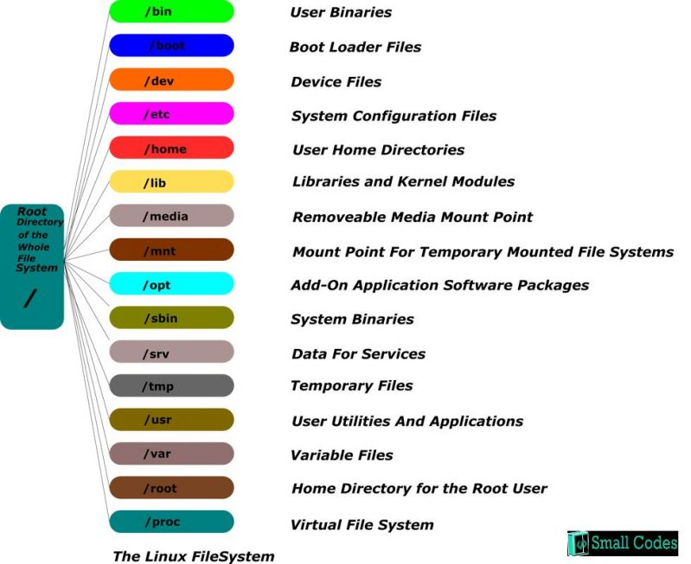
Notes:
Linux Directory Structure Theory
Let's have a theory Lecture First Here are the Linux Directory Structure (Read Below for each one):
1. / – root Every single file and directory starts from the root directory. Only root user has write privilege under this directory. Please note that /root is root user’s home directory, which is not same as /. 2. /bin – User Binaries Contains binary executables. Common linux commands you need to use in single-user modes are located under this directory. Commands used by all the users of the system are located here. For example: ps, ls, ping, grep, cp. 3. /sbin – System Binaries Just like /bin, /sbin also contains binary executables. But, the linux commands located under this directory are used typically by system aministrator, for system maintenance purpose. For example: iptables, reboot, fdisk, ifconfig, swapon 4. /etc – Configuration Files Contains configuration files required by all programs. This also contains startup and shutdown shell scripts used to start/stop individual programs. For example: /etc/resolv.conf, /etc/logrotate.conf 5. /dev – Device Files Contains device files. These include terminal devices, usb, or any device attached to the system. For example: /dev/tty1, /dev/usbmon0 6. /proc – Process Information Contains information about system process. This is a pseudo filesystem contains information about running process. For example: /proc/{pid} directory contains information about the process with that particular pid. This is a virtual filesystem with text information about system resources. For example: /proc/uptime 7. /var – Variable Files var stands for variable files. Content of the files that are expected to grow can be found under this directory. This includes — system log files (/var/log); packages and database files (/var/lib); emails (/var/mail); print queues (/var/spool); lock files (/var/lock); temp files needed across reboots (/var/tmp); 8. /tmp – Temporary Files Directory that contains temporary files created by system and users. Files under this directory are deleted when system is rebooted. 9. /usr – User Programs Contains binaries, libraries, documentation, and source-code for second level programs. /usr/bin contains binary files for user programs. If you can’t find a user binary under /bin, look under /usr/bin. For example: at, awk, cc, less, scp /usr/sbin contains binary files for system administrators. If you can’t find a system binary under /sbin, look under /usr/sbin. For example: atd, cron, sshd, useradd, userdel /usr/lib contains libraries for /usr/bin and /usr/sbin /usr/local contains users programs that you install from source. For example, when you install apache from source, it goes under /usr/local/apache2 10. /home – Home Directories Home directories for all users to store their personal files. For example: /home/john, /home/nikita 11. /boot – Boot Loader Files Contains boot loader related files. Kernel initrd, vmlinux, grub files are located under /boot For example: initrd.img-2.6.32-24-generic, vmlinuz-2.6.32-24-generic 12. /lib – System Libraries Contains library files that supports the binaries located under /bin and /sbin Library filenames are either ld* or lib*.so.* For example: ld-2.11.1.so, libncurses.so.5.7 13. /opt – Optional add-on Applications opt stands for optional. Contains add-on applications from individual vendors. add-on applications should be installed under either /opt/ or /opt/ sub-directory. 14. /mnt – Mount Directory Temporary mount directory where sysadmins can mount filesystems. 15. /media – Removable Media Devices Temporary mount directory for removable devices. For examples, /media/cdrom for CD-ROM; /media/floppy for floppy drives; /media/cdrecorder for CD writer 16. /srv – Service Data srv stands for service. Contains server specific services related data. For example, /srv/cvs contains CVS related data.

Slide 8
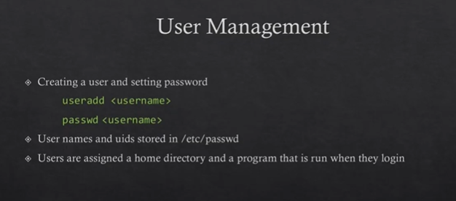
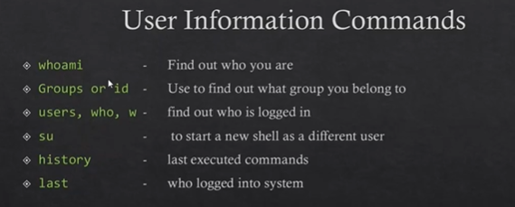
Notes:
useradd <name>
passwd <name> give the password twice
su <name>
User information will be at /etc/passwd
pwd
echo
sudo
clear
x=100
echo $x

Slide 9
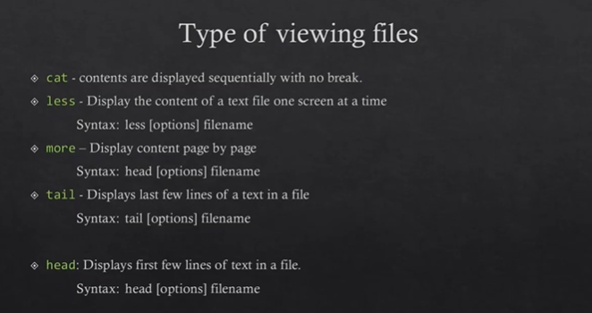
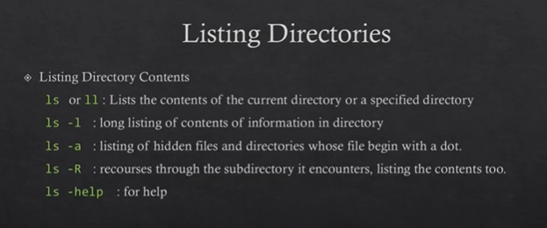
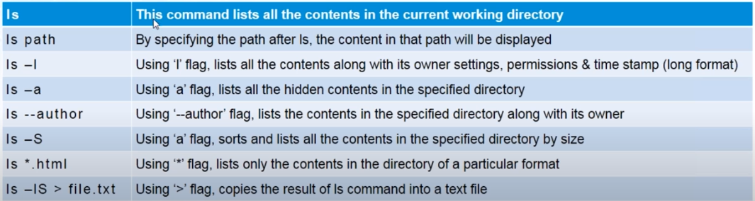
Notes:
Creation of a file
vi <filename>
nano <filename>
touh <filename>

Slide 10
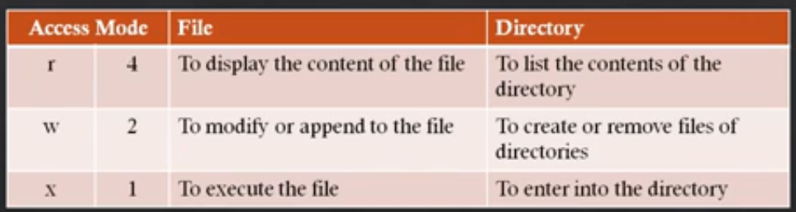
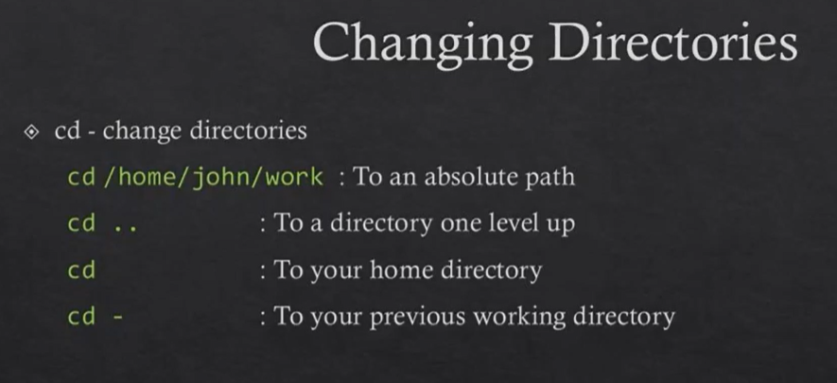
Notes:
chmod –R → is used to change permission
pwd -- > present working directory
mkdir dir1 dir2 dir3
date → check date and time
cal -- > calendar for current month
cal 2019 -- > year’s calendar
cp <source file > < destination file>
mv <source file > < destination file>
rmdir → to remove directory
rm -rf <filename> -- > remove a file
cd ‘xyz pqr’
To check how many file system is there -- > df –h [du –h will give in human readable format ]
du –k /dev -- > which file is using how much space .
find <dirs> [condition] [action]
gzip and gunzip
tar a file using command -- > tar –cvf dir3.tar dir3
unzip using tar –xvzf dir.tar
wc <passwd> -- > tells you how many lines – words – characters are there in the file .
sort <filename> for sorting
sort –n <filename> for sorting on numeric value

Slide 11
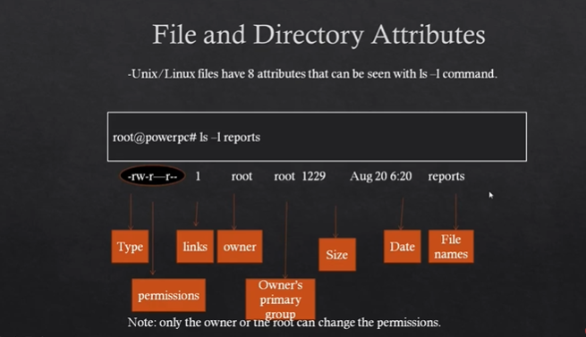
Notes:
umask -- > check the permission
grep is also a pattern search command
echo “ comment”
ls –l > file2 -- > redirect command

Slide 12
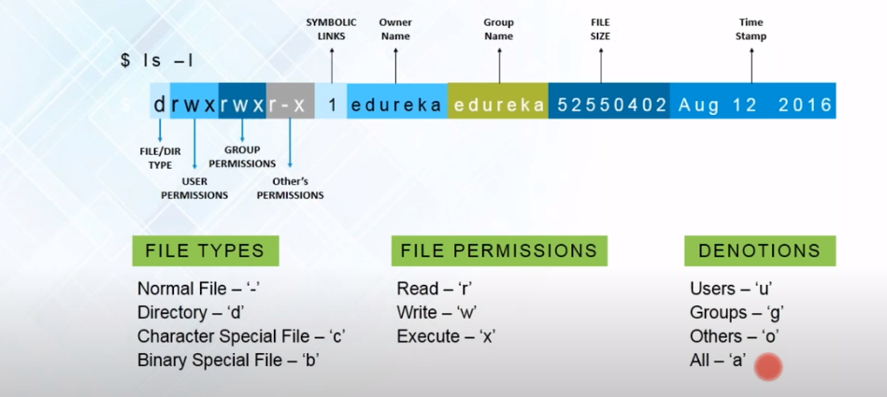
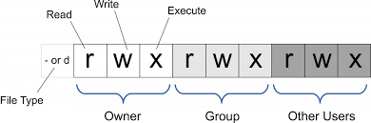
Notes:
Commands :
1. What is swap memory – Ram can park some work temporarily aside
2. Check space availability :
free –m
vmstat
top
htop
3 . What is a demon – package that run in the background
4 . Ps –ef | grep ‘http’
5 . ls –li
6 . How many partitions are there in linux ?
7 . mount -l
8 . locate <file_name>
9 . diff <> <>
10.

Slide 13
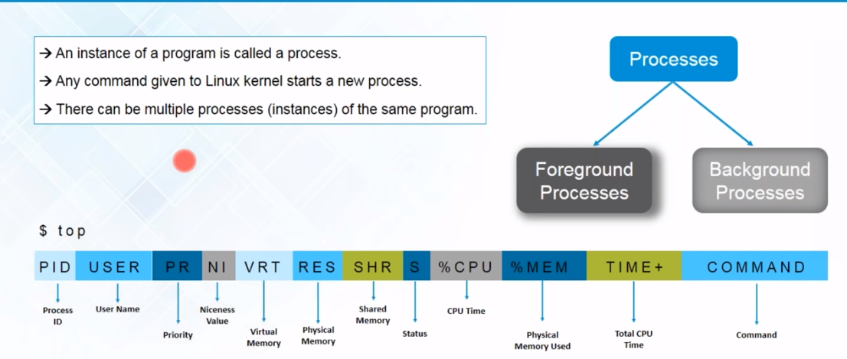

Slide 14
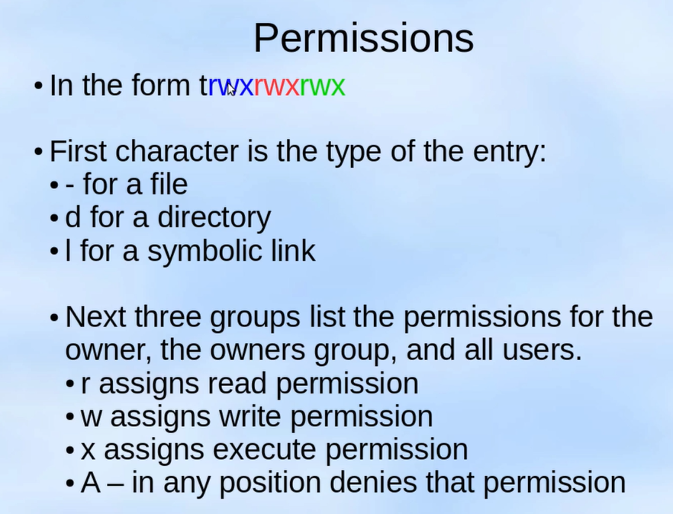
Notes:
cat > file1
cat file1
man file1
wc –w < file2
wc –w < file3> wordcount

Slide 15
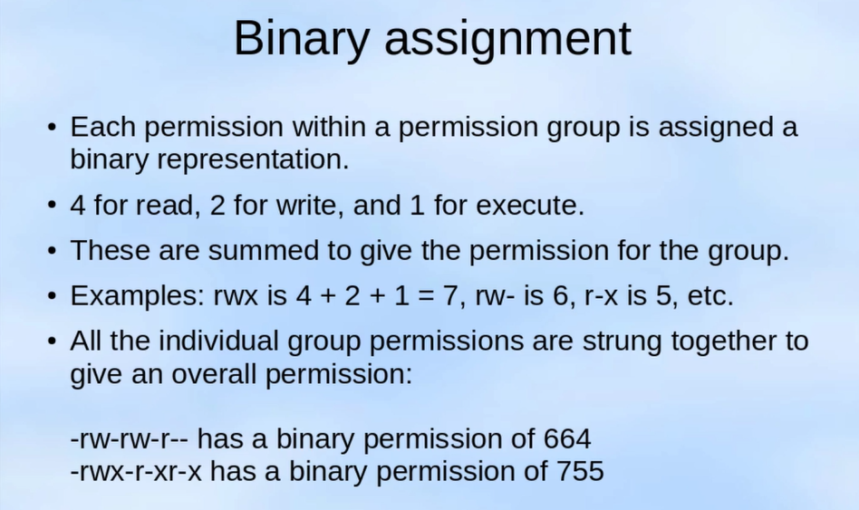
Notes:
free -g – memory in GB
vmstat –a -- detailed statics
sar –u – cpu usage
e2fsck –f /dev/linux – to check if u have any problem n that file system
cat /proc/meminfo

Slide 16
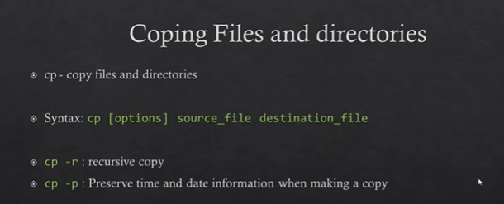
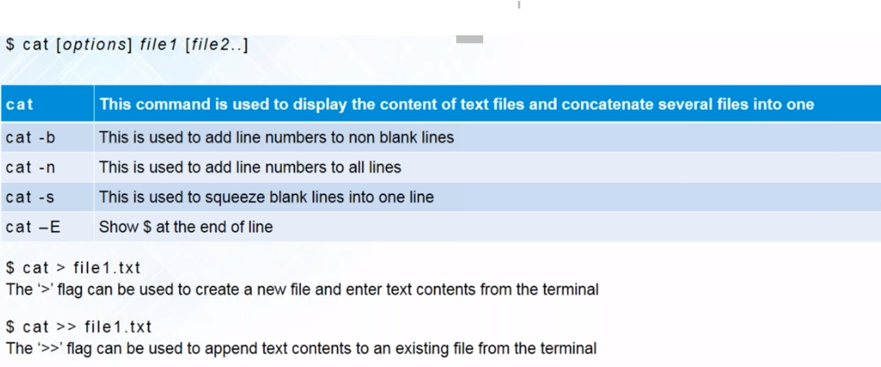
Notes:
uptime – tells you since how long session is active
lsblk – this command will show you how many blocks/volumes are attached .
free –m to see available free space
cat /proc/cpuinfo -- > how much cpu is available
top -- > which process is eating more cpu
df –h -- > file system {like drive in windows}
find / -name <what you want to search>

Slide 17
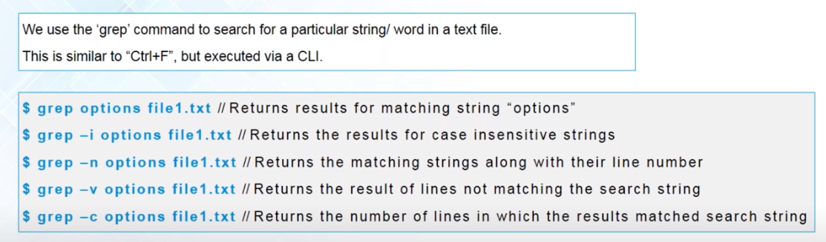
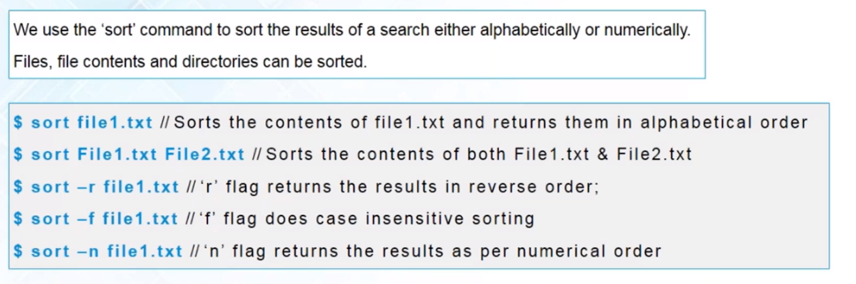

Slide 18
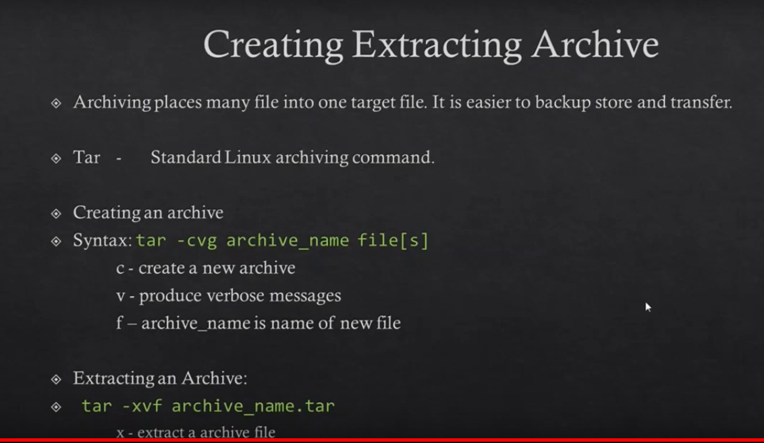

Slide 19
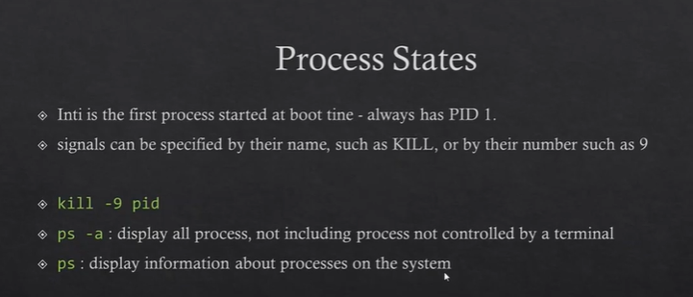
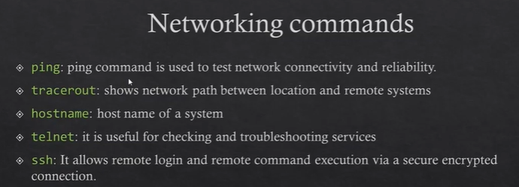

Slide 20
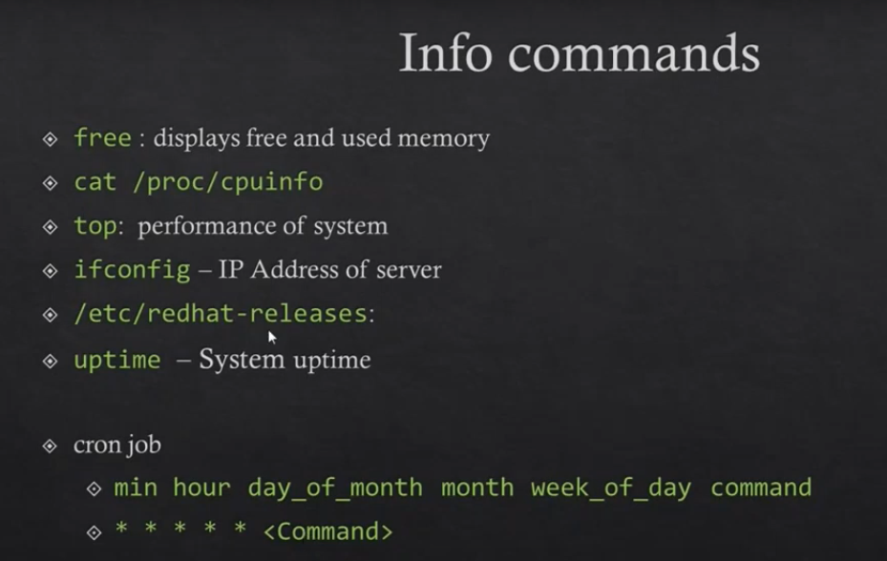

Slide 21
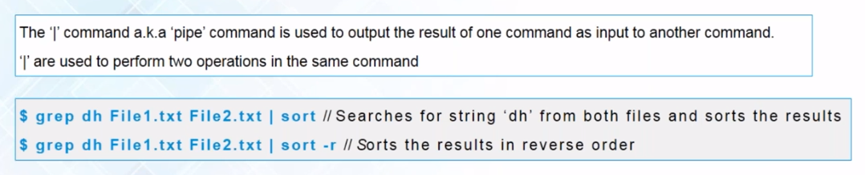
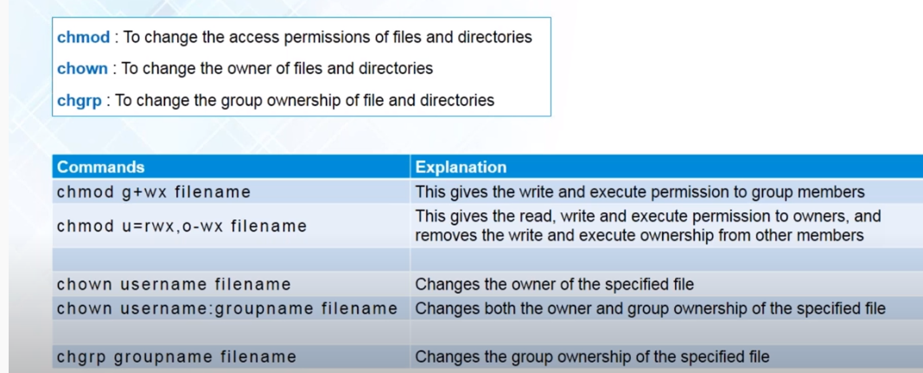

Slide 22
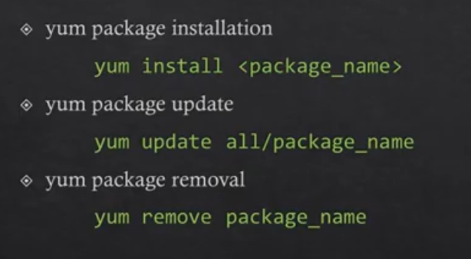
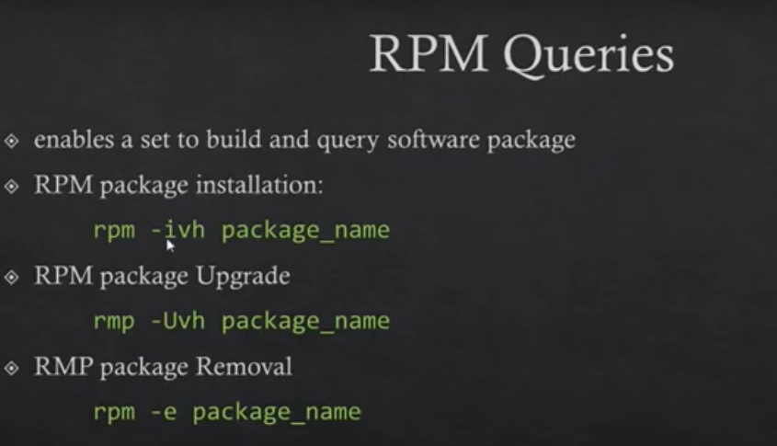
Notes:
yellow update manager
yum repolist
yum list installed
yum grouplist
tail -5 /var/log/yum.log
yum history
yum search <package name >

Slide 23
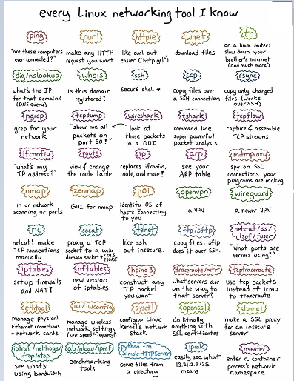
Notes:
ps aux | grep “java” -- > see where and all java is running
netstat -lpnt -- > list servers with active connections
usermod -aG sudo <username> -- >add user to sudo group to get root privilege

Slide 24

Bash SCRIPTING

Slide 25
Notes:
Script contains a series of command which is interpreted line by line and can automate real world tasks .
cat /etc/shells
which bash
#! /bin/bash – shabang -- interpreter to say which shell to use but may take the previously used interpreter
#!/usr/bin/python
print “ This is python script .”
chmod 755 hi.py
./hi.py
# single line comment
: ‘ < write whatever you want >’ -- multiline comment
=================================================
#! /bin/bash
SERVER_NAME=‘hostname’
echo “You are running this script on ${SERVER}”
=================================================

